Slide 1
Block Diagrams
Engineering 304 Lab

Slide 2
Outline
Overview of uses
Example DE2 Block Diagram
Level 0
Level 1
Level 2

Slide 3
Why Use Block Diagrams?
System Engineering is how you design a system with multiple components that interact
Much of your work in the future will be a form of system engineering
Less focus on the low level components
Move focus on how components connect together
Good tool for communicating your ideas
Helpful for dividing and conquering a complex design
E.g. senior design project

Slide 4
What are the different levels?
Level 0
Identifies system inputs, outputs, and function
Level 1
Identifies primary sub-systems, connections between them, and functionality of each
Level 2
For each primary sub-system, secondary sub-systems are identified.
Level n
Continues until you reach the lowest component level desired
Example follows for the DE2 board with a NIOS CPU

Slide 5
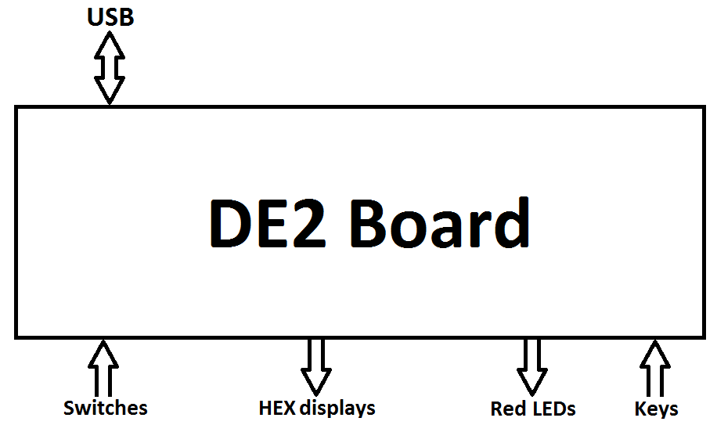
DE2 Board – Level 0

Slide 6
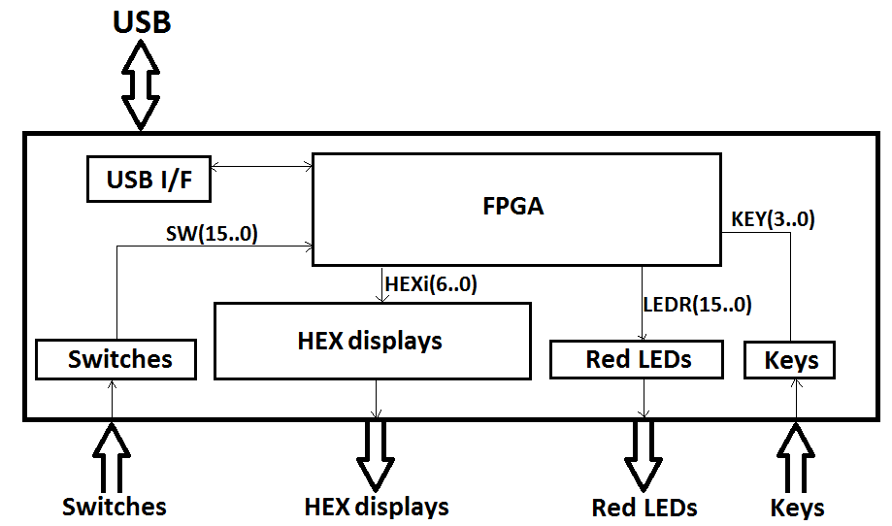
DE2 Board – Level 1

Slide 7
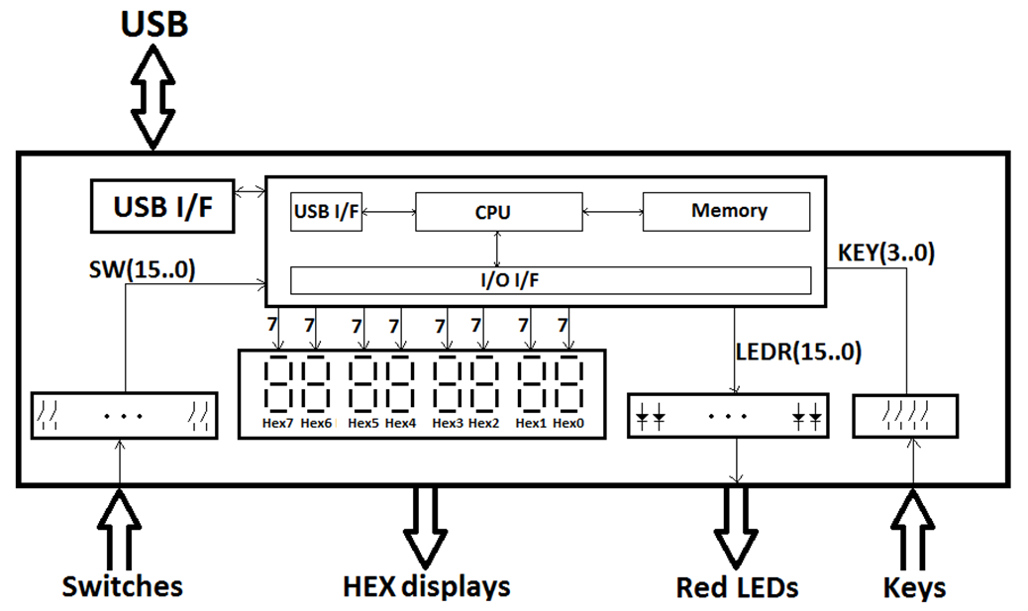
DE2 Board – Level 2

Slide 8
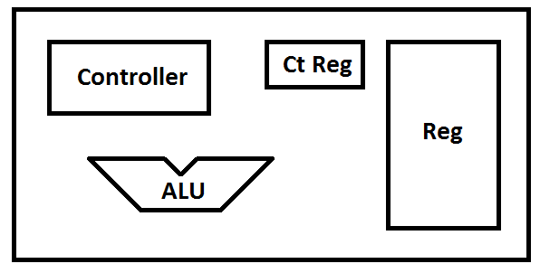
DE2 Board – Level 3 – CPU Only

Slide 9
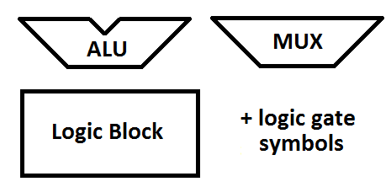
Common Logic Block Symbols

Slide 10
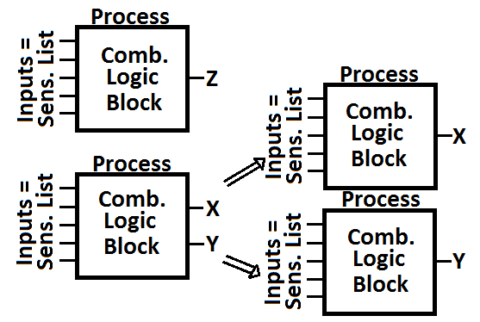
VHDL and Block Diagrams
A VHDL process should describe one (or a group) of blocks on your block diagram
VHDL processes should have only 1 output (or 2 if the two are almost identical)

Slide 11
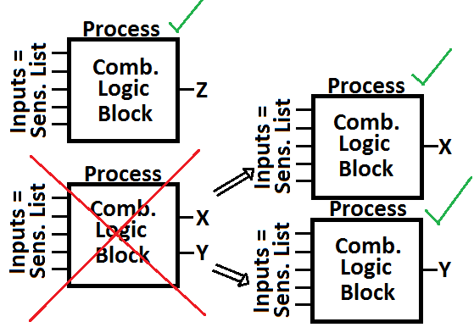
VHDL and Block Diagrams
A VHDL process should describe one (or a group) of blocks on your block diagram
VHDL processes should have only 1 output (or 2 if the two are almost identical)

Slide 12
MUX – Selected Signal Assignment
entity Multiplexer is
port( A, B, S : IN BIT ;
F : OUT BIT ) ;
end Multiplexer ;
architecture SelectedSignal of Multiplexer is
begin
with S select
F <= A when'0',
B when OTHERS ;
end SelectedSignal ;

Slide 13
MUX – Conditional Signal Assignment
entity Multiplexer is
port( A, B, S : IN BIT ;
F : OUT BIT ) ;
end Multiplexer ;
architecture ConditionalSignal of Multiplexer is
begin
F <= A when S = '0' else
B ;
end ConditionalSignal ;

Slide 14
MUX – Process If-Else
entity Multiplexer is
port( A, B, S : IN BIT ;
F : OUT BIT ) ;
end Multiplexer ;
architecture ProcessIfElse of Multiplexer is
begin
process( A, B, S )
begin
if S = '0' THEN
F <= A ;
else
F <= B ;
end if ;
end process;
end ProcessIfElse ;

Slide 15
MUX – Process Case Statement
entity Multiplexer is
port( A, B, S : IN BIT ;
F : OUT BIT ) ;
end Multiplexer ;
architecture ProcessCase of Multiplexer is
begin
process( A, B, S )
begin
case S IS
when '0' => F <= A ;
when OTHERS => F <= B ;
end case ;
end process;
end ProcessCase ;

